Slide 1

Sangam
A Cross-Sell Playbook
Cross-sell/playbook/Oct’21/V1

Slide 2

Playbook
Systems
Sangam Objective
Expected Benefits
Process Flow
Reward and Recognition for Generating Leads
References
Corporate Presentation
Product Presentations
Cross-Sell SPOC
Templates
Audio Visuals
Plug & Play email scripts
Pre-qualification Questionnaires

Slide 3

Systems
Standard
Operating
Procedures

Slide 4

Sangam Objective
Promote a culture of cross selling of group products among Avvashya Group sales employees
To gain knowledge of products and services offered by group companies
To understand the process of cross-selling and lead management process
Selling Skills - Learn the ways to find any other logistic requirements with existing customers as well as stages to build new customer

Slide 5

Expected Benefits
Helps pitching end-to-end relevant Solutions to Customers through a blend of Products
Develops self confidence amongst BDEs/BDMs to cross-sell products of group companies
Helps achieve better conversions/closing ratio
Easier and more effective product presentations
Establishes long term relationships with Customers

Slide 6
Process Flowchart
No – Try again in 1 month
1
Sales person generates leads, either from new customer or from existing customer
Check with existing clients, ongoing leads and references for requirements of Group’s services
Share lead with cross-sell team & Lead generating vertical SPOC
Yes
<2 days
2
Capture opportunity and share with Cross-sell Team
Periodic cadence of Cross-sell leads to qualify leads basis pre-determined criteria and status update
Vertical SPOC assign Lead Recipient
Lead Recipient to arrange for joint call with prospect along with Lead Generator to check if opportunity exists
Yes
Qualified
2-3 days
2-3 days
2-3 days
1-2 days
Source requirement from the customer for active opportunities through joint discussions with customer
3
Work with cross-function teams for solution designing or commercial proposal
4
RFQ received
If project feasible
Create RFQ response/proposal and financial quote for customer
Basis RFQ timeline
2-3 weeks
5
Submit RFQ and/or pitch to customer
If needed, pitch in joint meeting or with Sponsor for large opportunities
Follow up and negotiate with customer on conversion of opportunity
6
Approve/Disapprove business related exceptions with Legal and Finance teams
Create contract with Legal and Finance teams and get it signed by customer
If win
If win
Basis RFQ timeline
Up to confirmation
2-7 days
1-2 weeks
7
Alert Implementation team to begin execution
Assign customer to respective team
Monthly monitoring of account progress
Lead Generator task
4-5 days
1-2 days
Lead Recipient task
Cross-sell Team/Sponsor task
1
2
3
4
5
6
7
Pre-qualification of Leads
RFQ qualification
Financial assessment
Customer negotiation
Final sign-off
Performance tracking
Solution design

Slide 7
Reward & Recognition
Incentive structure
For every converted leads, sales person to be rewarded as per the “Sangam Sales Incentive Structure”
For each qualified lead converted into business, INR 5K be given as a reward to lead generator
Successful Lead Conversion
Continuous Lead Generation
Recognition at the group level
Monthly Group wide recognition for business units wise top 5 salesperson with most number of Qualified Leads
Weekly recognition for cross-sell champions in CMT call
Cross sell champion to be awarded in “Jashn” for sales.

Slide 8

References
Corporate Presentation
Detailed Corporate Presentation
Products Presentation
Sangam SPOC Details
Right click to open the Presentation

Slide 9








Our gamut of logistics solutions
NVOCC
FCL
Express Distribution
Air Freight
Container Freight Station (CFS)
Logistics Parks
Contract Logistics and Chemical Warehousing
E-commerce Logistics
Global Projects Logistics and
Engineering Solutions
Right click to open the Presentation

Slide 10
Cross-Sell SPOC Detail
Cross-sell email address: cross-sell@allcargologistics.com
Your Division/Zonal SPOC (you can check for it in the table below)
The Division/Zonal SPOC for whom the lead is intended (you can check for it in the table below)
FUNCTION_ZONE | FULL_NAME | EMP_EMAIL | EMP_MOBILE_NO
Gati East Zone | Harish Babu Sharma | harish.babu@gatikwe.com | 8894704101
Gati North Zone | Sunil Kumar Mishra | sunil.mishra@gatikwe.com | 9571299836
Gati South Zone | Anup Behera | Anup.behera@gatikwe.com | 9889009137
Gati West Zone | Yogesh Patle | patle.yogesh@gatikwe.com | 9916995395
Contract Logistics | Trupti Shetty | trupti.shetty@avvashyacci.com | 8454020831
NVOCC TN/AP/TS | Radha Ramakrishnan | Radha.Ramakrishnan@allcargologistics.com | 9840831711
NVOCC KA/North/West | Darshana Thakur | darshana.thakur@allcargologistics.com | 9833031865
NVOCC East | Parameswar Das | Parameswar.Das@allcargologistics.com | 7044491180
FCL Division | Mihir Paleja | mihir.paleja@allcargologistics.com | 9619184808
CFS-ICD | Nobonita Acharya | cfsinsidesales@allcargologistics.com | 8657410547
Projects & Equipment | Harshil Shah | Harshil.Shah@allcargologistics.com | 9930235630

Slide 11

Templates
Audio Visual
Standardized Email
Pre-qualification Questionnaires

Slide 12
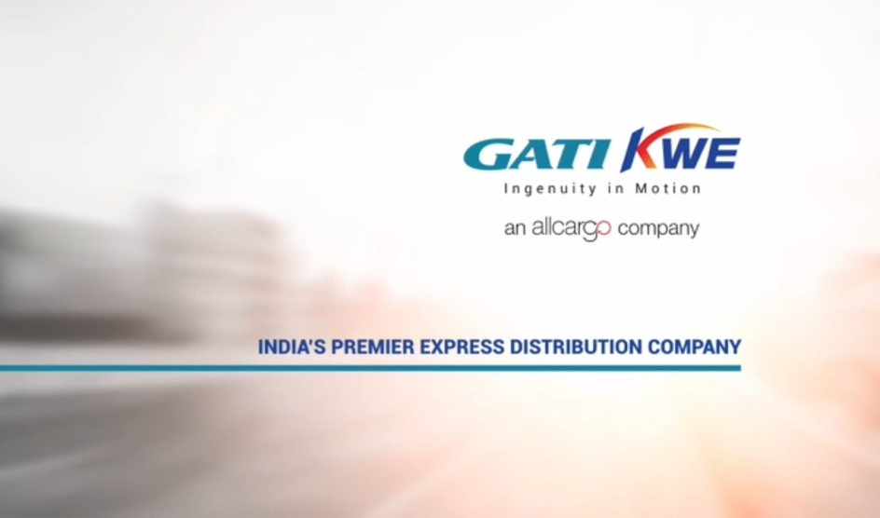
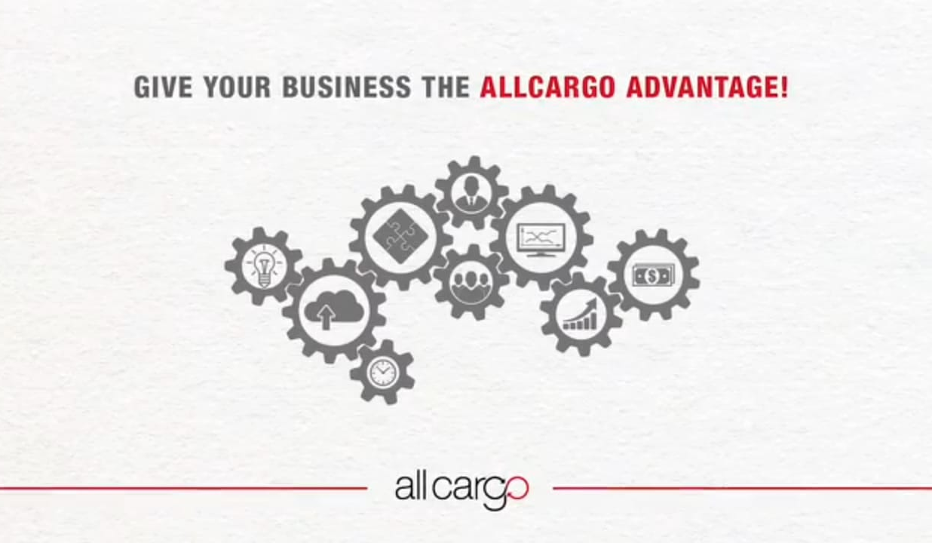

Draft – Standardized Email & AV For Customers
Gati-KWE AV:
Allcargo AV:
Right click to open the Presentation

Slide 13
Pre-qualified Questionnaires
Full Container Load (FCL) | Container Freight Station (CFS) | Contract Logistics | Gati-KWE
Less Container Load (LCL)
Whether it is Export/Import /Both | Are you taking DPD-DPD or DPD-CFS import deliveries | The location where the customer is looking for space | Whether it is PTL (part truckload) or FTL (full truckload), domestic air movement
Customer to have official domain and not Gmail, Yahoo, etc |  | PAN India Warehousing Network: Factories, Warehouses, RDCs
What is the Cargo | The monthly volume of imports at JNPT (in TEU's) | Tentative space required | What is the cargo
Whether it is Air/Ocean /Both | Import deliveries at laden/factory de-stuff or CFS de-stuff | Type of operations (rack, ground, etc) | Volume per month (tons)
Shipment Term (FOB, CIF) | Type of imports HAZ or non HAZ, ODC, etc | Product detail | Major destinations
Volume per month | Current CFS services at JNPT | Who manages the biggest warehouse in the network (Self or 3PL)
CBM (in case of LCL)
TEU's (in case of FCL)
Destinations | CHA who are doing custom clearance | Cargo Volume, pallets required to store

Slide 14


THANK YOU!
Contact: cross-sell@allcargologistics.com

