Slide 1


Global LCL Leader and India’s Largest Integrated
Logistics Services Provider

Slide 2






The Combined Strengths
that move you across the world!
Global logistics conglomerate, headquartered in India
Established market leadership across diverse logistics verticals through well-timed capacity building, mergers and acquisitions, and strategic partnerships
Experience and expertise in NVOCC (LCL & FCL), Ground Express, CFS, Contract Logistics, Logistics and Industrial Parks
(NVOCC) Non-Vessel Operating Common Carriers | (LCL) Less than Container Load | (FCL) Full Container Load | (CFS) Container Freight Stations

Slide 3




Our Global Footprint
Presence in
180 countries
2400 direct trade lanes
World's #1
LCL Consolidator
Headquartered in
India (Mumbai)

Slide 4



Our Global Footprint
Europe
37
52
Countries
Offices
Americas
Asia Pacific
50
134
25
67
Countries
Offices
Countries
Offices
Head Office
(Mumbai)
Over
ISC, ME & Africa
300
68
122
Countries
Offices
Offices in
180
Countries

Slide 5

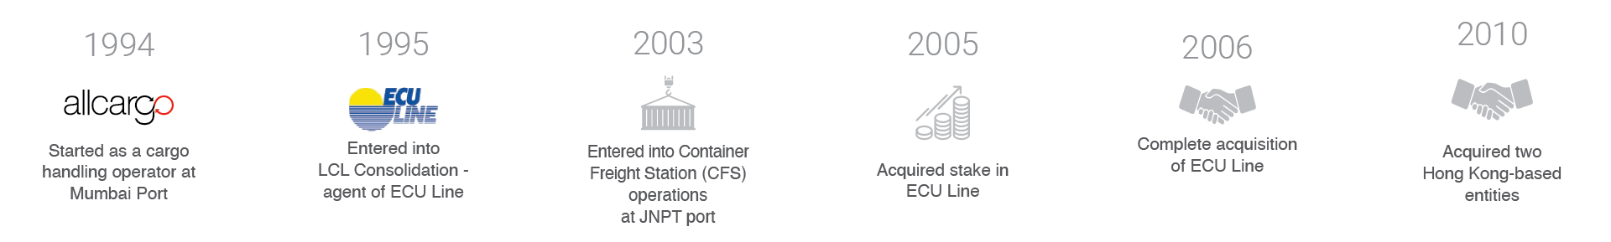
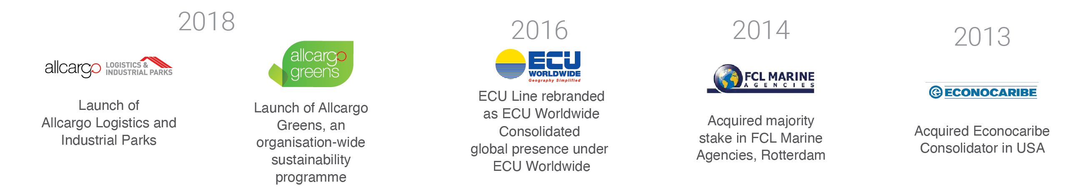
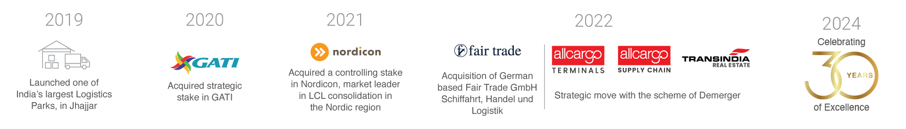
3 Decades of Expertise

Slide 6

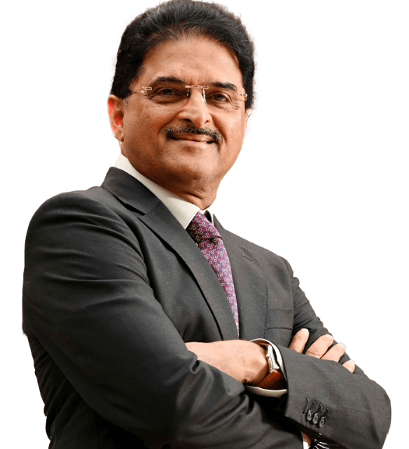
Shashi Kiran
Shetty
Founder and Chairman
Allcargo Group
A visionary industry veteran leading Allcargo Group to success in 180 countries and coverage spanning the whole of India. Mr. Shetty believes in embracing change, adopting digital technology and fostering collaboration with all stakeholders. He is a philanthropist and an avid golfer.

Slide 7

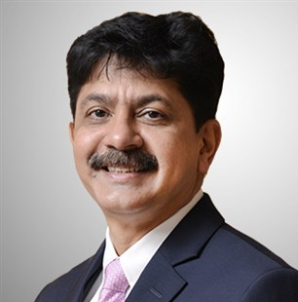
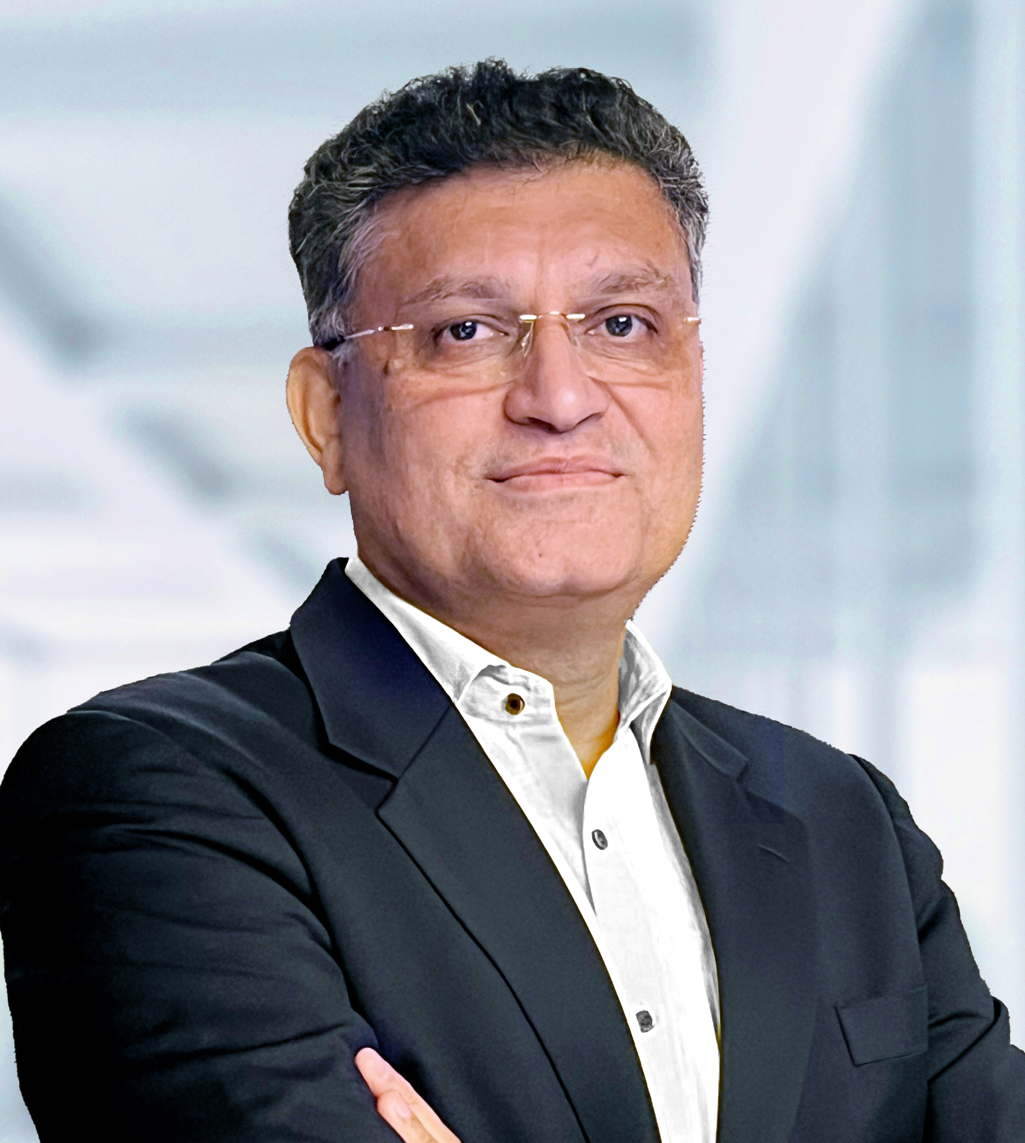
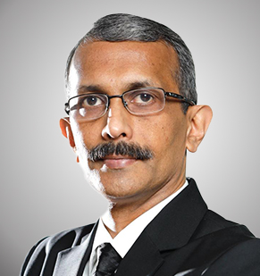
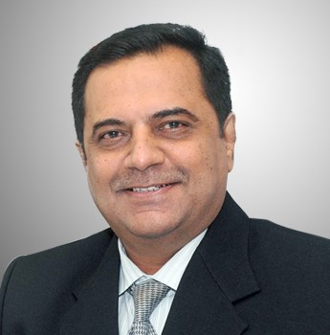
Experienced and Proven Leadership Team
Allcargo is led by a visionary management and senior leadership team of seasoned professionals, with wide-ranging experience and expertise in their areas of specialisation.
Adarsh Hegde
Managing Director
Allcargo
Ketan Kulkarni
Managing Director &
Chief Executive Officer
AllcargoGATI & Allcargo Supply Chain
Suresh Kumar
Managing Director
Allcargo Terminals
Jatin Chokshi
Managing Director
Transindia Real Estate

Slide 8






At The Core Of Our Operations
Our Vision
Ingenuity in motion to serve stakeholders for market
leadership, by far.
Our Values
Entrepreneurship with a Purpose
Practice the owner’s mindset, as the organisation is the collective soul of its employees. Be unwilling to accept ‘it cannot be done’ as an answer. Take initiative to push limits. Use resources consciously, chase goals aggressively,
be frugal and pursue passion for business excellence.
Customer Centricity
Recognize that our customers are the reason for our existence. Be obsessive about delighting customers and all stakeholders. As our Vision and Mission suggest, go to infinite ends to deliver the best customer experiences.
Innovation and Execution
Constantly strive to challenge conventional views and drive innovation with new ideas, a futuristic outlook and perspectives from the youth. Maximise impact by delivering world-class solutions leveraging IT, digital platforms and
newer technologies. Be agile, flexible and lead the disruption.
Collaboration
Build a highly capable and committed team to build growing businesses which deliver highest value by fostering a meaningful relationship with all stakeholders by practicing highest standards of business ethics, humility and governance.
Care for Environment and Society
Always aim to minimise the impact on environment, supporting scientific research that reflects environmental and sustainability concerns. Build a culture of empathy within the companies towards colleagues as well as underprivileged individuals around us. Be responsible corporate citizens and contribute to a better society, country and world at large.
Our Mission
Always be customer-centric and proactive. Create digitally-enabled, well-governed, logistics magic, worldwide.
The purpose of our business is to dedicatedly serve to ensure stakeholder delight and influence the environment and society at large with our good work, as we abide by our values that form the cornerstone of our business strategies, decisions and activities.
We are committed to this roadmap as we seek to grow sustainably and deliver logistics solutions with excellence, again and again, with a lot more rigor and enthusiasm as the days pass.
Shashi Kiran Shetty
Founder and Chairman, Allcargo Group
Our Purpose
Helping global supply chains,
while caring for sustainability

Slide 9
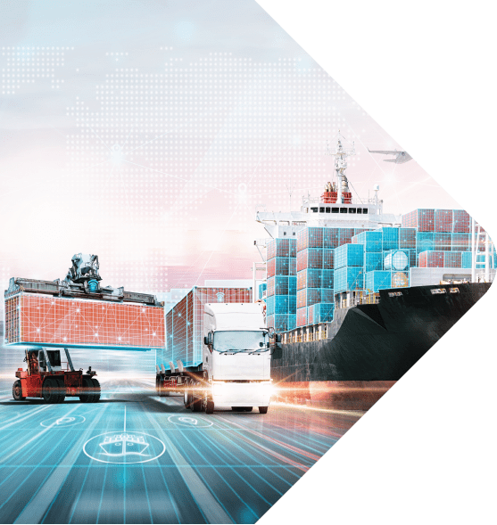

Ingenuity In Motion
To Deliver Global End-to-End
Logistics Solutions

Slide 10
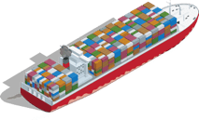
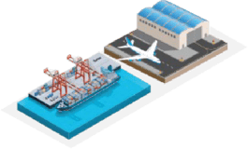



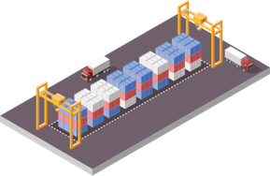

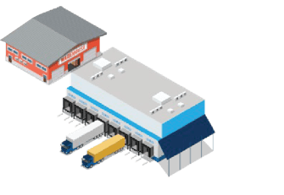
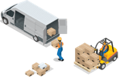


Our Range of Logistics Solutions
International Supply Chain Solutions
Air Freight
World’s No.1 LCL consolidator and dedicated FCL services provider
International and domestic air freight expert
CFS
Contract Logistics
India’s widest CFS-ICD Network
Scalable and flexible supply chain solutions with 70+ warehouses
Ground Express
Logistics & Industrial Parks
India’s premier Ground Express company
Built-to-suit, Grade-A logistics and industrial parks

Slide 11
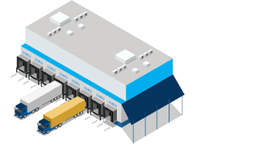


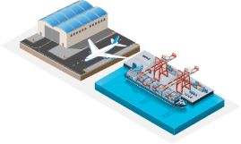



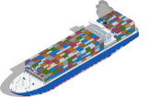

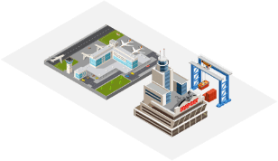


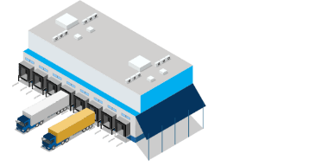




Allcargo’s end-to-end multi-modal delivery
Consolidation at
Point of Origin
CFS | Customs | Documentation Support
Departure Terminal
Inland
Movement
Port of Origin
Your Premises/
Warehouse
Air Freight
Receiving Terminal
Ocean Freight
Destination
CFS | Customs | Documentation Support
Port of Destination
Deconsolidation/ Warehousing
Reverse Logistics
Your Premises/ Warehouse
Inland Movement/ Ground Express Across Country

Slide 12

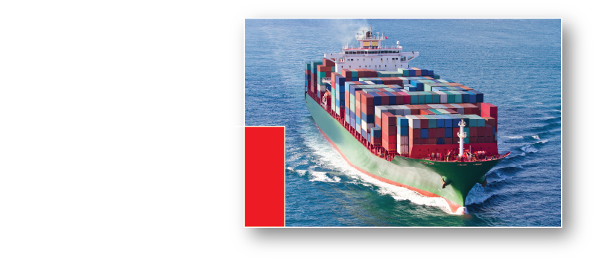

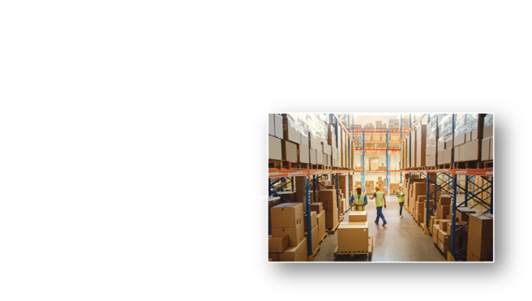
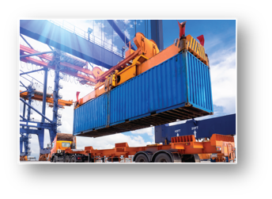
International Supply Chain Service from the
World’s No.1 LCL Consolidator
Import and export services
- Over 2400 direct trade lanes | 180 countries |
Operates across 40,000 port pairs
Door-to-door deliveries over 50 markets globally
- Quick access and bookings through ECU360.
Innovative products tailored to your needs
– XLERATE | Reefer logistics | Multi-City Consolidation | Transhipment | Customized Value-added services |
ODC and hazardous cargo movement
Ground Express
across India with
first and last-mile deliveries
Support of our
own CFS network

Slide 13
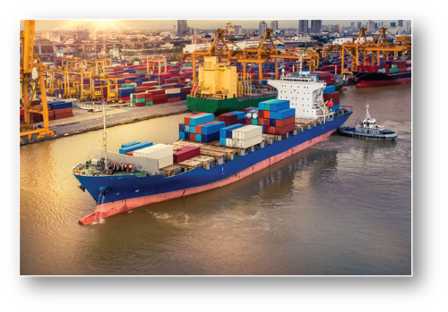



Dedicated neutral FCL services that
connect you to the world
Transport of heavy, out-of-gauge, break bulk cargo, Intermodal & multi-modal solutions
Better control and lower costs with offices at both, origin and destination
Dedicated FCL team
Expertise across industries
Complete transparency on solutions
Optimised cost and time of transportation

Slide 14
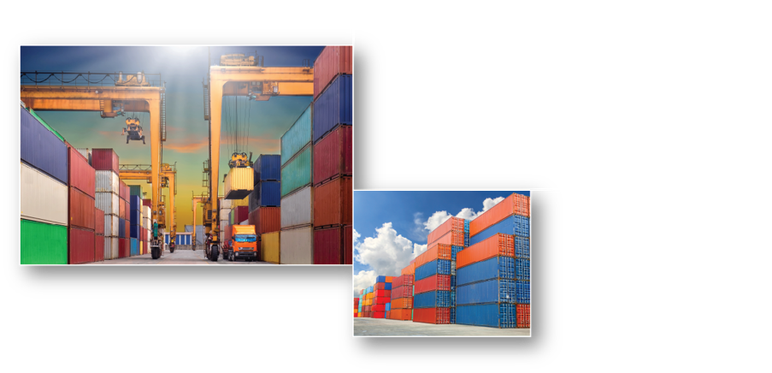


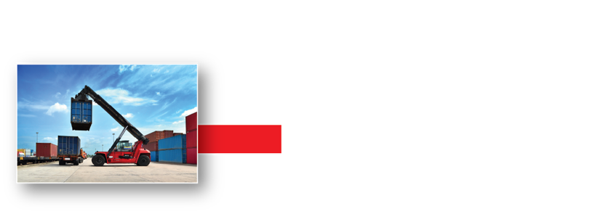
India’s Widest CFS Network
Built to Meet Global Standards
Multi-City Consolidation and Direct Port Delivery
First and last mile delivery
ODC handling
Reefer containers
Hazardous cargo handling
World-class CFS facilities
Mumbai
Mundra
Kolkata
Chennai
Dadri
Safe, secure bonded and non-bonded warehouses
International safety and security standards compliant – C-TPAT, ISO and OHSAS.
Technology enabled operations
- RFID, e-bill of lading, e-payment, etc.
Equipment maintenance, repairs and backup support

Slide 15
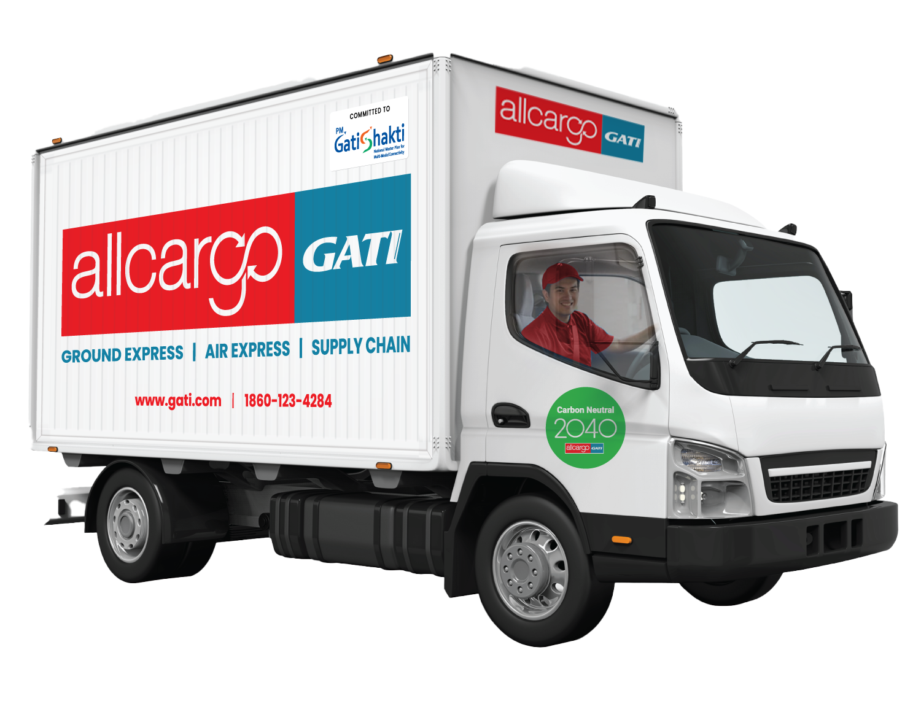



Safe and Timely
Express Distribution Across India
Extensive coverage spanning the whole of India.
End-to-end multi-modal deliveries for time-sensitive parcels, with first and last mile solutions.
Solutions and expertise across sectors
State-of-the-art technology –
Optimal routing schedules
Reverse logistics
Visibility and tracking
Unparalleled network of channel partners so you save on time and costs.

Slide 16



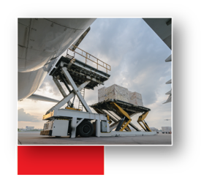
Air Freight Solutions
that Connect you to the World
International Air Freight
World’s key business centres and trade destinations.
Compliance with local regulations and local expertise.
Value-added services – Inland trucking and warehousing.
Domestic Air Freight
Transit centers at 34 airports across India, covering 100%
of India’s commercial airports.
Strategic alliance with India’s leading airlines to offer more than 1500 departures a day.
On-time deliveries of your cargo across the whole of India.

Slide 17
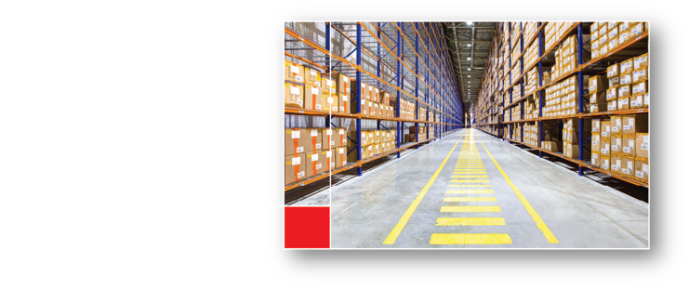
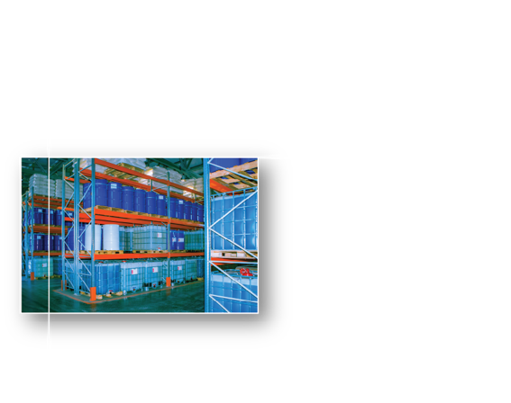


Contract Logistics Solutions
that Simplify your Supply Chain
57 strategically located warehousing facilities across India that meet international standards.
Scalable and flexible supply chain solutions
Experience industry sectors – Chemicals, Spare Parts, Pharmaceuticals, Food, Fashion, Retail and e-commerce.
Chemical warehousing facilities pan-India.
Adhering to global safety standards.
Complete adherence to temperature control requirements.
Hazardous product storage in accordance to the Globally Harmonized System (GHS) hazard class.
Expertise in last-mile deliveries, bonded and general warehousing, mother warehouse management for OEMs and dealers, domestic and international transportation.
Digital tools and optimized operations

Slide 18
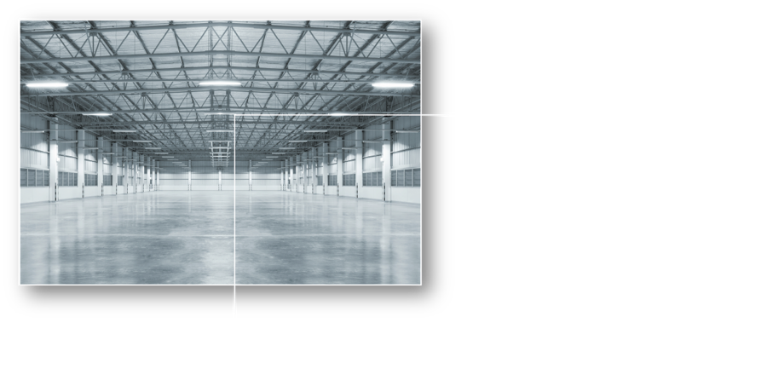
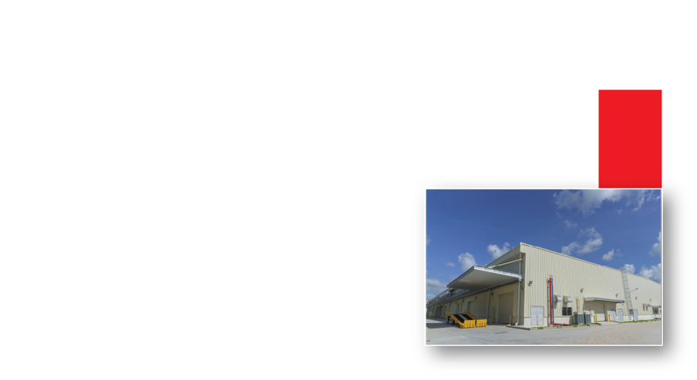



Strategically Located
Logistics Parks Across India
Built-to-suit, Grade-A logistics parks across Ahmedabad, Bengaluru, Delhi NCR, Goa, Hosur, Hyderabad, Mumbai and Pune.
Close connectivity to industrial hubs, transport routes and consumption centres.
Facilities built to international safety and engineering standards, incorporating sustainable construction for resource optimization.
Fully and semi-automated warehousing solutions
Flexibility of dedicated and shared user solutions for warehousing and transportation as per your requirements.

Slide 19

Future-ready Operations
Driven by Robust
Digital Transformation

Slide 20




Four Pillars of Digital Transformation
INFRASTRUCTURE
Setting up tech-enabled facilities, warehouses, Surface Transhipment Centres, etc. with sophisticated Warehouse Management Systems and automation that empowers human capital
Leveraging technology to reduce energy consumption, minimize environmental impact and adhere to global Environmental, Social and Corporate Governance (ESG) standards
CUSTOMER EXPERIENCE
ECU360 to help customers conduct business 24x7 with just a click
Customer service and assistance accessible across digital presences like website, apps, WhatsApp chatbot, customer portal, social media, etc.
TEAMS
Enterprise-wide connected digital systems and tools like CRM, Business Intelligence frameworks, HR portals, etc. to make internal operations optimal and efficient
Bolstering teams with safe, secure access to online sites and networks for maintaining productivity
PARTNERSHIP
White-label technology products along with API/EDI integration that cascade digitalization and its benefits to SMEs, freight forwarders and key accounts
Online training for vendors and partners to enhance skills

Slide 21
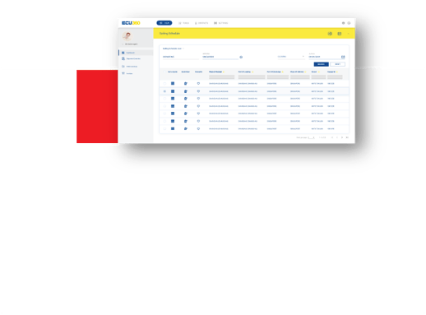

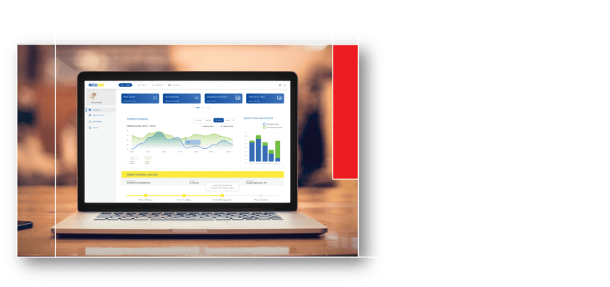
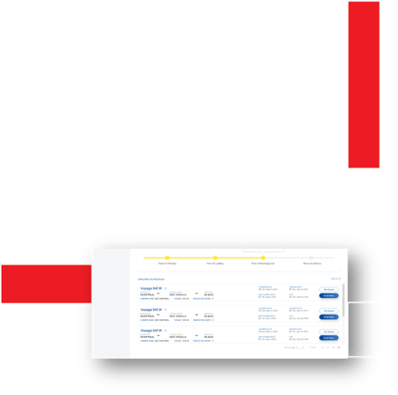






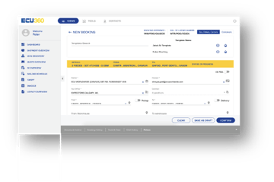


An Integrated Platform
for all your Shipping Needs
Business Insights
Reusable Templates
Automated Push Reports
Personalized Dashboards
Instant Door-to-Door quotes
Quick Booking
Enhanced Track & Trace

Slide 22






Our Commitment to Environment, Social, and
Corporate Governance
Environment:
Committed to reducing our carbon footprint and minimising environmental impact.
Our Founder and Chairman, Mr. Shashi Kiran Shetty is a signatory to the 'Statement of Support' of the Forum Supply Chain & Transport Community to accelerate a zero-emission future
Over 1 million trees planted to green the earth's cover
Electricity generation using solar power to help reduce carbon emissions
Social:
Inclusive programs in Education, Environment, Health, Women Empowerment, Disaster Relief, and Sports
We have made a difference to over 4,00,000 lives to date
Employee volunteering encouraged through activities like clean-up drives, running marathons to support social causes, blood donation camps, etc.
We encourage Diversity and Inclusion with team members from various cultures and nationalities, and more than 50% women in our global workforce
Corporate Governance:
We adhere to the highest standards of governance, creating an enabling ecosystem
Certified ISO 31000 framework for risk management and ISO 27001 for information security
Business conducted in a free, fair, and ethical manner
Well-defined plan for business continuity and to build resilience

Slide 23


The Allcargo Advantage
Reliability in our DNA that delivers peace of mind, every time.
Expertise across almost all diverse logistics verticals to offer customized, end-to-end solutions for multiple sectors
A future-ready approach led by innovation, ingenuity and adoption of digital tools and technology
Unmatched synergies of a global network spanning 180 countries and domestic coverage spanning the whole of India
Commitment to grow sustainably and deliver excellence with value-driven action and highest levels of corporate governance

Slide 24


Thank
You
www.allcargologistics.com

