Slide 1

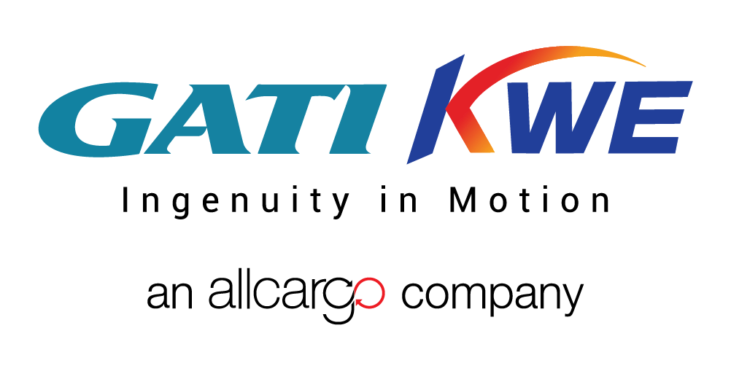
THE COMBINED STRENGTHS TO ANSWER YOUR LOGISTICS NEEDS

Slide 2
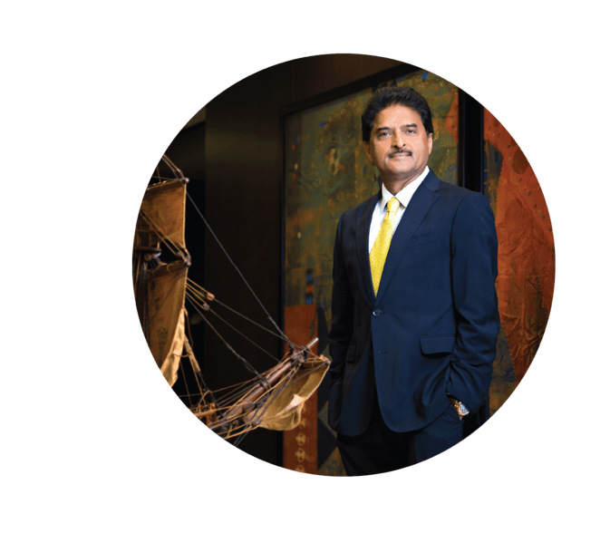
The founder
Shashi Kiran Shetty
Chairman - Allcargo Logistics, ECU Worldwide, Gati Ltd.
A visionary industry veteran leading the group to success in 180 countries and a coverage spanning the whole of India.
Mr. Shetty believes in embracing change, adopting digital technology and fostering collaboration with all stakeholders.
He is a philanthropist and an avid golfer.

Slide 3
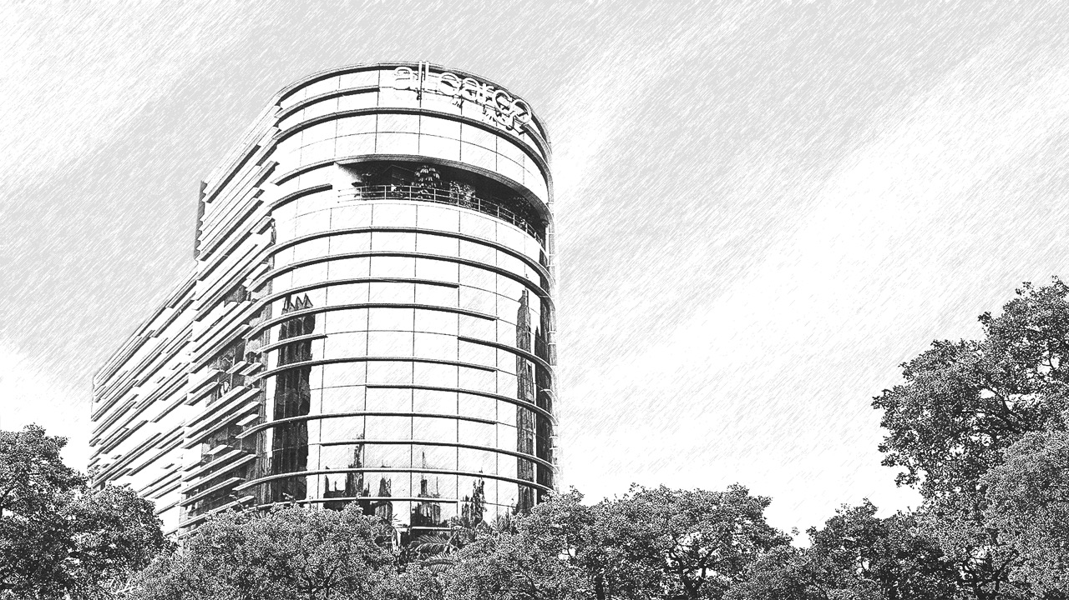
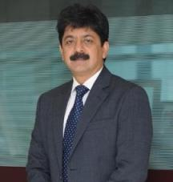

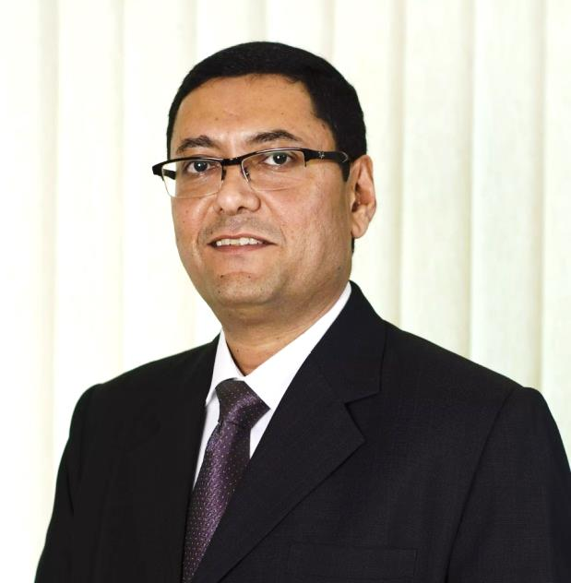
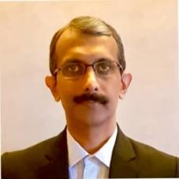
Experienced and proven leadership team
Allcargo Logistics is led by a visionary management and senior leadership team of seasoned professionals, with wide-ranging experience and expertise in their areas of specialisation.
Adarsh Hegde
Tim Tudor
Pirojshaw Sarkari (Phil)
Suresh Kumar
Joint Managing Director,
Allcargo Logistics
Chairman and Managing Director
Gati-KWE
CEO,
ECU Worldwide
CEO
Gati
CEO – India
Allcargo Logistics Ltd.

Slide 4


OUR COMBINED STRENGTHS
Nationwide presence covering 735 out of 739 districts across India
More than 300 offices in 180 countries, with movements on over 2,400 tradelanes
Strong management team backed by a
team of over 10,000 professionals
India's widest CFS-ICD network with presence at key ports that handle nearly 80% of the total container volume in India
World's no. 1
LCL Consolidator
India's leading Express Logistics partner
First mover in multimodal logistics parks across India
Strong technological
platform

Slide 5
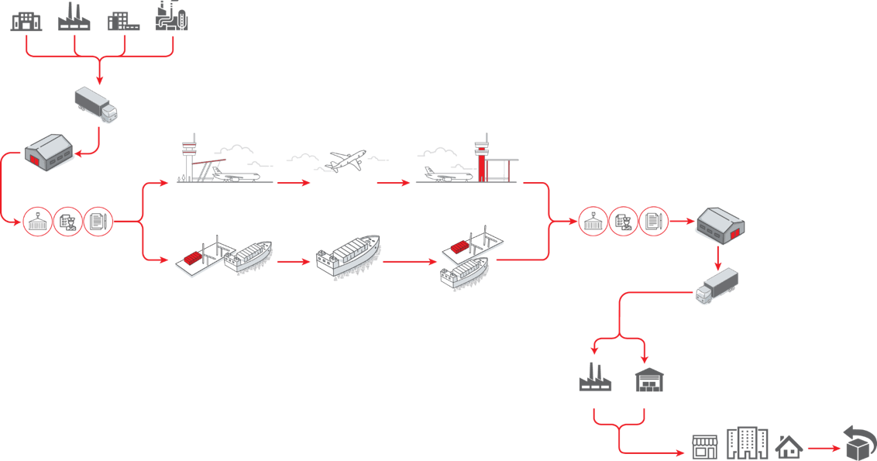
Your Premise / Warehouse
Delivering a true one-stop logistics solution for your cargo
Consolidation
at Point of Origin
Departure Terminal
Air Freight
Receiving Terminal
Deconsolidation /
Warehousing
CFS | Customs |
Documentation Support
CFS | Customs |
Documentation Support
Inland Movement /
Express Distribution
Across Country
Port of Origin
Ocean Freight
Port of Destination
Your Manufacturing Facility / Warehouse
Allcargo’s end-to-end multi-modal delivery
Reverse
Logistics
Destination

Slide 6

INDIA’S LARGEST INTEGRATED LOGISTICS COMPANY

Slide 7
OUR JOURNEY
Acquired
Econocaribe Consolidator
in USA
  Acquired
  stake in
  ECU Line
  Created ACCI -
  Making a strong entry into chemicals warehousing sector
  Consolidated global presence under ECU Worldwide
  ECU Line rebranded as
  ECU Worldwide
  Entered into LCL Consolidation -
  agent of ECU Line
  Completed
  25 years
  in logistics
2005
  Began
  CFS operations in Chennai and Mundra
2013
1995
2019
2007
2016
  Entered into Container Freight Station (CFS) operations near JNPT port
  Listed on
  BSE & NSE
  Complete acquisition of ECU Line
  Acquired majority stake in FCL Marine Agencies, Rotterdam
  Launch of
  Allcargo Logistics
  & Industrial Parks
  Launch of
  Allcargo Greens
  Started as a cargo handling operator at Mumbai Port
  Acquired
  strategic stake
  in Gati
  Acquired 2
  Hong Kong
  based entities
1993
2003
2006
2010
2014
2018
2020

Slide 8
END-TO-END LOGISTICS SOLUTIONS TAILORED TO YOUR NEEDS
NVOCC
(LCL | FCL | Air Freight)
Container Freight Station (CFS)
Contract Logistics and Chemical Warehousing
E-Commerce Logistics
Global Projects Logistics and
Engineering Solutions
Logistics Parks

Slide 9
ALLCARGO SOLUTIONS
NVOCC
THE GLOBAL LCL LEADER
Import and export services - Over 2400 direct trade lanes | More than 4000 port pairs |Over 180 countries
Door-to-door deliveries in 52 markets globally– Quick access and bookings through ECU360
Innovative products tailored to your needs – XLERATE | Reefer logistics | Multi-City Consolidation | Transhipment | Customized Value-added services | ODC and hazardous cargo movement
Express Distribution across India with first and last mile deliveries
DEDICATED FCL SERVICES
Expertise across industries
Ocean freight traffic on a multi-carrier principle
Optimised cost and time of transportation
Transport of break bulks, heavy or oversized goods, with the highest quality
Better control and lower costs with offices at both, origin and destination
Dedicated FCL team

Slide 10
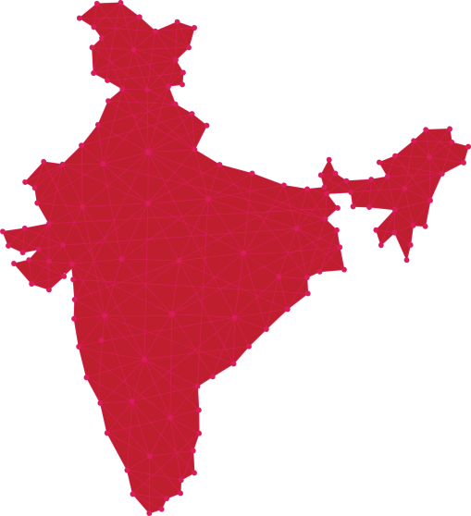
ALLCARGO SOLUTIONS
NVOCC
Ludhiana
Delhi
WITH A NETWORK
THAT MOVES YOUR BUSINESS
ACROSS INDIA.
Jaipur
Agra
Jodhpur
Kanpur
Gandhidham
Ahmedabad
Mundra
Baroda
Indore
Nagpur
Kolkata
Nashik
Mumbai
Aurangabad
Pune
Vizag
Hyderabad
Belgaum
Goa
Mangalore
Bangalore
Chennai
Tirupur
Salem
Coimbatore
Karur
Cochin
Tuticorin

Slide 11


ALLCARGO SOLUTIONS
Container Freight Stations
Dadri
INDIA’s WIDEST CFS ICD NETWORK
Pioneer in CFS Industry in India
World-class CFS facilities – Mumbai, Mundra, Kolkata,
Chennai and Dadri
Safe, secure bonded and non-bonded warehouses
Multi-City Consolidation and Direct Port Delivery
First and last mile delivery | ODC handling | Reefer containers | Hazardous cargo handling
Equipment maintenance, repairs and backup support
International safety and security standards compliant –
C-TPAT, ISO and OHSAS
Technology enabled operations - RFID, e-bill of lading,
e-payment, etc.
Mundra
Distance from Port: 8 KM
Kolkata
Distance from Port: 2 KM
Nhava Sheva, Mumbai
Distance from Port: 18 KM
Chennai
Distance from Port: 8 KM

Slide 12
ALLCARGO SOLUTIONS
Contract logistics
69 strategically located warehousing facilities across India that meet international standards
Scalable and flexible supply chain solutions designed by professionals who understand your business
Expertise in last-mile deliveries, bonded and general warehousing, mother warehouse management for OEMs and dealers, domestic and international transportation
Digital tools and optimized operations deliver a tangible boost
in your productivity and a reduction in TAT
Experience industry sectors – Chemicals, Spare Parts, Pharmaceuticals, Food, Fashion, Retail and E-commerce
Chemical warehousing facilities pan-India
Adhering to global safety standards
Complete adherence to temperature-control requirements,
safety regulations
Hazardous product storage in accordance to the Globally Harmonized System (GHS) hazard class

Slide 13
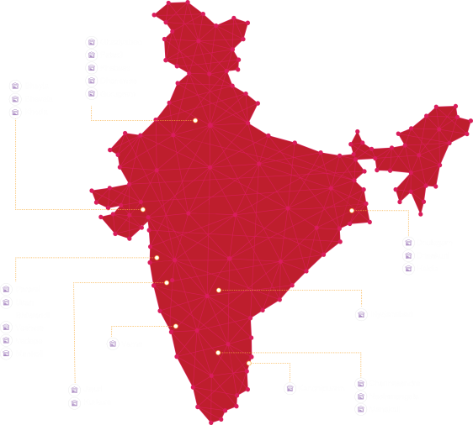
ALLCARGO SOLUTIONS
Contract logistics
PAN-INDIA PRESENCE
Chemical compliant warehouse measuring
7 lac sq.ft. at Panvel (Mumbai)
69 warehouse locations across India
Over 100 customers spanning across focused industry sectors
Over 5 million sq.ft. of built-up warehousing space across India
Expected warehouse utilization levels of 97%

Slide 14
ALLCARGO SOLUTIONS
Project logistics
Factory-to-foundation solutions across India, Nepal, Bangladesh, Bhutan, Myanmar, Malaysia, Philippines, Indonesia, Sri Lanka, Africa, etc.
End-to-end solutions – With shore-based management, road and barge transport, equipment leasing, jetty design and construction and control tower
Own equipment fleet, trained experts and operators to help you navigate infrastructural challenges
Cranes ranging from 50 MT to 750 MT
High safety standards and compliance to ensure you experience ‘zero-incident’ project sites
Solutions across sectors – Infrastructure & EPC, Power & Grid, Fertilizers, Oil & Gas, Heavy Civil and more

Slide 15
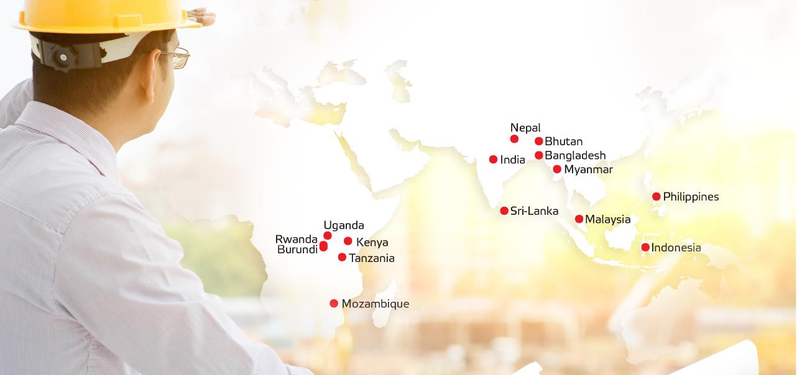
ALLCARGO SOLUTIONS
Project logistics – expertise across the world

Slide 16
ALLCARGO SOLUTIONS
Logistics Parks
Build Your World in Ours
Key strengths:
Built-to-suit, Grade-A logistics parks across Ahmedabad, Bengaluru, Delhi NCR, Goa, Hosur, Hyderabad, Mumbai and Pune
Close connectivity to industrial hubs, transport routes and consumption centres offering significant locational advantage
Facilities built to international safety and engineering standards, incorporating sustainable construction for resource optimization
Fully and semi-automated warehousing solutions
Flexibility of dedicated and shared user solutions for warehousing and transportation as per your requirements

Slide 17
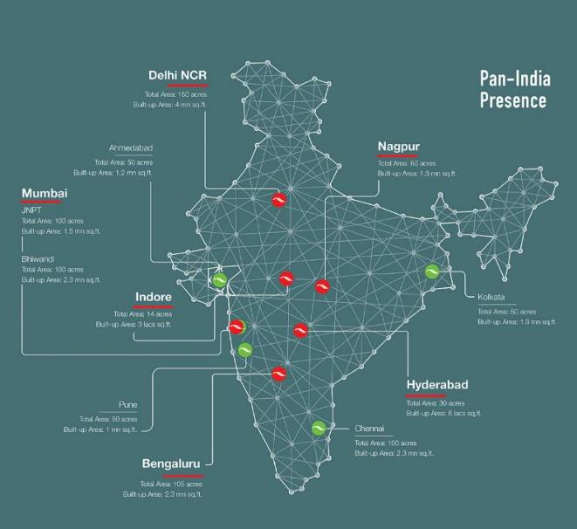
ALLCARGO SOLUTIONS
Logistics Parks

Slide 18

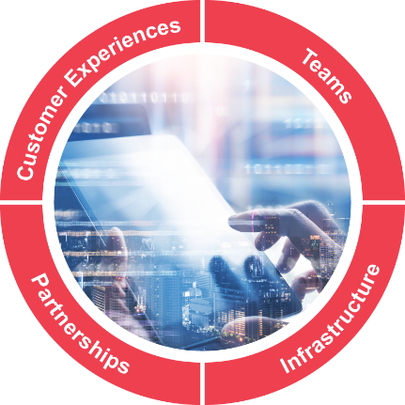

Four pillars of digital transformation
ECU360 to help customers
conduct business 24x7 at their convenience and ship with just
a click
Customer service and assistance accessible across digital presences like website, apps, WhatsApp chatbot, customer portal, social media, etc.
Enterprise-wide connected digital systems and tools like CRM, Business Intelligence frameworks, HR portals, etc. to make internal operations optimal and efficient
Bolstering teams with safe, secure access to online sites and networks for maintaining productivity even during remote operations
Transforming
White-label technology products along with API/EDI integration that cascade digitalization and its benefits to SMEs, freight forwarders and key accounts
Online training for vendors and partners to enhance skills
Setting up tech-enabled facilities, warehouses, Surface Transhipment Centres, etc. with sophisticated Warehouse Management Systems and automation that empowers human capital
Leveraging technology to reduce energy consumption, minimize environmental impact and adhere to global Environmental, Social and Corporate Governance (ESG) standards
© 2021 Allcargo Logistics All rights reserved

Slide 19

THE WORLD’S NO. 1 LCL CONSOLIDATOR
www.ecuworldwide.com

Slide 20
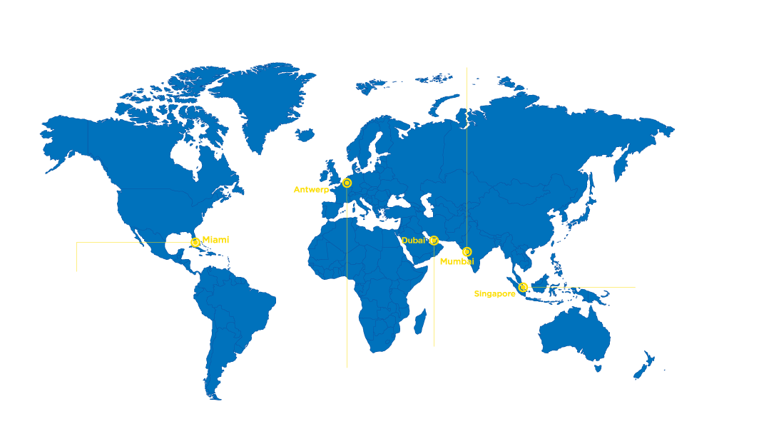

GLOBAL NETWORK
Head Office
and
Indian Sub-Continent Regional Office
More than
2,400
direct trade lanes
Antwerp
Presence in
180
Miami
Dubai
countries
Mumbai
Americas
Regional Office
Singapore
Asia Pacific
Regional Office
Operating through more than
300
Middle East and Africa
Regional Office
offices
Europe
Regional Office

Slide 21
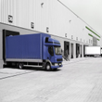

CARGO MOVEMENTS THAT CONNECT YOU TO THE WORLD
LCL
FCL
Air Freight
Warehousing
Cross-border
movement

Slide 22


ECU WORLDWIDE SOLUTIONS
LCL
Global leader in LCL consolidation
Largest global LCL network.
Largest pool of experienced specialists assuring excellent service delivery
Local expertise to handle customs and compliance
HUBS at all major locations across the globe for faster connectivity
Partnerships with core carriers
Large volumes leading to preferential freight rates with shipping lines
Global network leveraged to serve trade lanes that reduce transhipment cost and time - eliminates multiple cargo handling
The ECU Advantage
Largest global
LCL network
Partnership with
core carriers
Trade lanes that reduce
transhipment cost and time

Slide 23
ECU WORLDWIDE SOLUTIONS
FCL
Solutions that ensure you have all the information you need
Ocean freight solutions based on multiple carrier options as per your needs
Optimised time and cost of transportation through multiple carriers
Transport of heavy, out-of-gauge and break--bulk
Offices at origin and destination enabling better operational control and efficiency
Door-to-door shipments across continents
Dedicated team for FCL operations and advisory
The ECU Advantage
Owned and operated offices
at origin and destination
Solutions based on
multiple carrier options
Transport of heavy,
Out-of-gauge, and break bulk

Slide 24

ECU WORLDWIDE SOLUTIONS
AIR FREIGHT
We have detailed knowledge of aircraft types and capacities
Our team of experts well-versed in local regulations across different continents
Time bound shipments, every time
Avail of optimum air cargo rates
Well-connected network accessible through remote locations
Local expertise to handle customs and compliance
The ECU Advantage
Time-bound
shipments
Optimum
air cargo rates
Well-connected
network

Slide 25
ECU WORLDWIDE SOLUTIONS
MULTI-MODAL TRANSPORT
Our special expertise in cross-border handling for better safety and handling of cargo
Vast presence that helps with necessary permits and clearances
Support solutions and escorts wherever necessary
Compliance with all regulatory codes and standards
We are proud to be a logistics partner to the United Nations for NGO movement in Africa.

Slide 26
ECU WORLDWIDE SOLUTIONS
WAREHOUSING
State-of-the-art facilities
Trained professionals, equipment and latest technology
Scalable supply chain solutions
Assured safety and quality
Owned and operated warehouses across the continents

Slide 27














ECU WORLDWIDE SOLUTIONS
VALUE-ADDED SERVICES
Export LCL
Consolidation
Gateway Solutions
Local Pickup and
Delivery (DAP/DDP)
Import LCL
Deconsolidation
Dangerous Goods
Handling
Warehousing
Export FCL and
Import FCL
Household Goods
Handling
Palletizing, Crating
and Packaging
Transhipment
Custom Clearance
Project Logistics
Multimodal Transport
Operation
Trucking/Drayage
Container
Freight Station

Slide 28

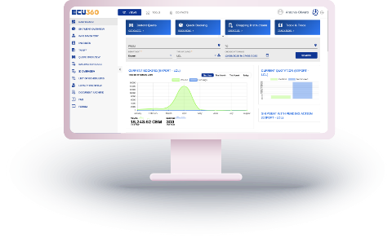
One integrated platform for your needs
Up-to-date schedules with instant 24x7 door-to-door
quotes for your LCL shipments
Online bookings in seconds
Convenience of door-to-door pricing
Personalised dashboards with reusable smart templates
Automated push reports and Business insights
Enhanced visibility with easy live cargo tracking
Online submission of shipping instructions
Combined strengths of ocean freight and road transport
360-degree view to the customer – Modern and integrated
OCR – Improve productivity with faster data capture
API/EDIs Integration with shipping lines and customers
Reliable | Scalable | Secure
© 2021 Allcargo Logistics All rights reserved
www.allcargologistics.com

Slide 29

INDIA’S LEADING EXPRESS LOGISTICS PARTNER
www.gati.com

Slide 30
GATI-KWE JOURNEY
Receives ISO Certification
Introduces 3PL in India
Begins multi-modal solutions, courier services and international operations to SAARC countries
Forays into Singapore
Sets up Gati Millennium Express: First cargo train of Gati
Ventures into Cold Chain Logistics
Introduces VTS –
Vehicle Tracking System
Sets up centralized call centre at Nagpur
Acquires Kausar,
cold chain solutions
2014 − Completes 25 years
Expansion of Cold Chain Vertical through warehouses
Establishes e-Fulfilment centres
BSI Certified – ISO 9001:2015
Tie-up with postal departments of Bhutan and Maldives
Sets up the P. D. Agarwal Development Centre for employee training
Becomes an integrated Supply
Chain Solutions provider
Signs a Joint Venture agreement with Kintetsu World Express for its Express Distribution and Supply-Chain business
Launches Supply Chain Management solutions
Launches Gati Student Express
Introduces customer convenience centres
Gati is founded
Expansion to Nepal
Allcargo acquires
strategic stake in Gati
1989-95
1996-98
1999-00
2001-03
2004-06
2007-08
2009-12
2013-19
2020

Slide 31





INDIA’S LEADING END-TO-END LOGISTICS SOLUTIONS
End-to-end logistics solutions – Multi-modal solutions across road,
rail and air
Covers over 99% of the country’s districts
Over 500 pick-up points across India
The most preferred partner for end-to-end logistics across India
End-to-end
solutions
Dedicated 24x7 support
Experience across
industries
Deliveries to
over 19,800
pin-codes
Network of
over 600 offices, including
18 large hubs

Slide 32
SUPPLY CHAIN SOLUTIONS FOR ALL YOUR NEEDS
Express Logistics
e-Commerce Logistics
Air Freight
Supply Chain Solutions

Slide 33
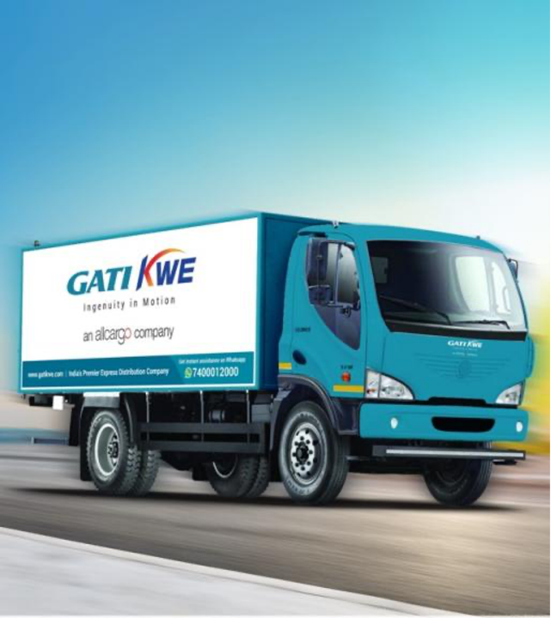








GATI-KWE SOLUTIONS
Express distribution
Complete range of Express Distribution solutions that give you the freedom of choice.
Multi-modal delivery to 99% of the country’s districts
Move time-sensitive parcels, freight or special cargo.
Express Plus
Faster delivery
Express
Cost-effective surface cargo movement
Premium Plus
Delivery within
12 hours or before noon the next day
Premium
Delivery within
24 hours, 48 hours and more than 48 hours
The Gati Express Distribution Advantage
Customised
end-to-end logistics
solutions
Unparalleled reach to over 99% of India’s districts
State-of-the-art tracking solutions
Quick and trusted claim process
Over 5,000 trucks and rail services
Over 600 offices
Reverse logistics expertise
Guaranteed
on-time deliveries

Slide 34







GATI-KWE SOLUTIONS
E-COMMERCE LOGISTICS
India’s first integrated e-Commerce logistics solutions provider
Expertise in last-mile deliveries
Solutions to cover all your needs – whether you serve individuals or enterprises
The Gati e-Commerce Logistics Advantage
Value-added service like COD, Card Payments and more
Return to origin and Return to vendor solutions
Order consolidation and one-ship solutions
API-enabled - Real-time tracking and update
Fulfilment centers - Shared and dedicated
Unparalleled reach to over 19,800 pin-codes
24x7 support

Slide 35




GATI-KWE SOLUTIONS
AIR FREIGHT
Expertise in moving cargo across India’s urban and
non-urban areas
Tie-up with IndiGo to give a unique advantage of a wide reach
More than 1,500 departures per day
Option to choose between Premium and Premium plus solutions
Own assets and vehicles to deliver to remote locations from
the airport
The Gati Air Advantage
Tie-ups with India’s leading commercial airlines
Customised solutions tailored
to your business needs
Unmatched convenience –
multiple cut-offs, late pickups,
next day deliveries
Smooth connectivity with
no cooling period

Slide 36





GATI-KWE SOLUTIONS
SUPPLY CHAIN MANAGEMENT SOLUTIONS
Seamless management of your supply chain.
Solutions to add value at every stop
Strong infrastructure with support that offers
Shop floor automation
World-class material handling
Racking and conveyor belts
Tech-enabled Warehousing solutions
The Gati Supply Chain Advantage
Best-in-class
Warehouse
Management
System
Integrated
Warehousing
and Distribution
Option of order
and inventory-based
models
Inventory and
purchase order
management
Customised
solutions for
multiple industries

Slide 37

Technology & Communication
Work Flow Based Operation Modules
Load, Delivery, and Pick-up planning modules that help us plan ahead
Metric Monitoring dash boards available at all operating units to keep track of network, stock and monitor service levels
Real Time Monitoring and Control on Remote Locations
Mobile Applications and Tablets
Ensures faster pick-up times through remote pick up delegation to concerned area associate
Data integrity ensured as all applications are linked with central data servers
Docket entry and printing at customer’s site enabling faster pick-up
Delivery information captured along with POD image
Gati-KWE’s digital payment
Customers convenience and efficiency is what matters to us at Gati-KWE. Which is why our new modes of digital payment give you the comfort of paying for your cargo movement, the way you want.

Slide 38

Technology & Communication
IT Network
All Gati- KWE Distribution Centers are networked via GEMS (Gati Enterprise Management System) Real time ERP
Advanced Tracking Systems (Vehicle & Packages)
Centralized Network Monitoring cell and 24/7 real-time Vehicle tracking System
App Based, On-line, SMS and E-mail Tracking options for customer
IVR Based Shipment tracking System
Bar Code Scanners
Ensures periodical stock taking at all distribution centers
Faster scanning of POD and Quick identification of missing shipments
On-line Customer Portal
Single window platform to keep track of all shipments and transactions
Real-time updates of your shipment
View & Download Invoices and monitor service levels & track of payments and outstanding bills

Slide 39



Introducing
Gati Genie on whatsapp
Gati Genie gives you the ability to get cost estimates, transit times, tracking updates,
and complaint directly on your mobile phone.
All you need to do is send 'Hi' to 74000 12000
on Whatsapp and let Genie assist you with anything you need.

Slide 40
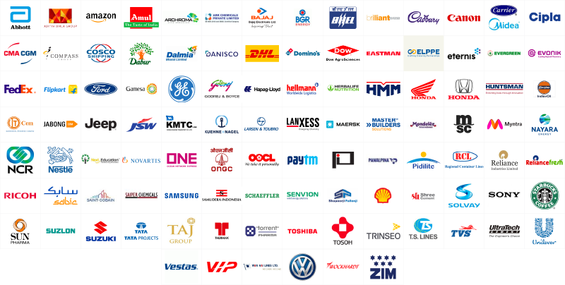
Marquee customers across industries
All logo and company names are trademarks™ or registered® trademarks of their respective holders. Use of them does not imply any affiliation with or endorsement by them.

Slide 41







INDUSTRY CERTIFICATIONS
At Allcargo, we are constantly looking at improving the way we deliver solutions to our customers to support their logistics needs.
Our processes, equipment and facilities are regularly certified and benchmarked to global standards, so our customers expect nothing less than global standards from us.
Break Bulk
License
CHA
License

Slide 42



Corporate Social Responsibility initiatives
Over 36 people-centric, participative initiatives and projects being run across the country, impacting more than 42,000 lives
With a vision to plant a million trees, more than 650,000 fruit-bearing trees have been planted under our Maitree initiative to increase the Earth's green cover and provide livelihood to farmers in tribal communities
Numerous relief activities like food distribution to vulnerable and underprivileged individuals, monetary contributions, funding for PPE for frontline healthcare workers, construction of houses, etc. carried out to spread hope and smiles, especially during tough situations like the global COVID-19 pandemic
Areas we contribute to
Environment
Education
Healthcare
Disaster Relief
Women Empowerment
Sports
Our key projects
Growing future with tree plantation
Skill development
program
Cataract diagnosis
and operations program
Our initiative towards sustainable tomorrow
www.allcargologistics.com

Slide 43

The Allcargo advantage
Leadership
Reliability in our DNA that delivers peace of mind, every time
Expertise across almost all diverse logistics verticals to offer customized, end-to-end solutions for multiple sectors
A future-ready approach led by innovation, ingenuity and adoption of digital tools and technology
Unmatched synergies of a global network spanning 180 countries and domestic coverage spanning the whole of India
Commitment to grow sustainably and deliver excellence with value-driven action and highest levels of corporate governance
Excellence
Innovation
Reliability
Network
Expertise

Slide 44



Phone: +91 86575 46262
Write: letspartner@allcargologistics.com
Visit: www.allcargologistics.com
Thank You
Follow Us:
Watch Allcargo Corporate AV – Click Here
(Right click and Open hyperlink)
Watch Gati-KWE Corporate AV – Click Here
(Right click and Open hyperlink)
Get a glimpse of our global presence, challenging projects and senior leadership talks through our digital magazine, Compass.
www.compassdigimag.com

